Slide 1
Communication Arts
Curriculum

Slide 2
Full Value agreement

Slide 3
Kitchen Capers
Kitchen Capers
Objectives:
Brainstorm
Be creative
Work with limited resources within a tight deadline
Present in a creative way
Infomercial
Infomercial requirements

Slide 4
Pipe cleaner towers
SUMMARY
Students work in groups of 3-4 to design and build the tallest freestanding tower using teamwork and simple materials while adjusting to changing constraints.
Video clip for after activity: Begin at 7:30 minutes, end at 11:50 Highest Tower Clip
Learning Objectives
After doing this activity, students should understand:
The concept of limited resources and constraints
The importance of teamwork and communication
The importance of planning a project

Slide 5
Paper Penny Bridge
SUMMARY
Student teams learn about the engineering design process and physical forces by building a bridge from a single sheet of paper and up to five paper clips that will span 20 cm and support the weight of 100 pennies. Like real engineers, teams also have limited budgets and must make trade-offs in materials.
Penny Bridge Success!
Car Drives Over Bridge Made of Paper
Learning Objectives
After doing this activity, students should:
Understand the process of planning and gaining approval for projects
Understand the importance of engineering in bridge design

Slide 6
Just a Minute!
Exit slip for Just a Minute
SUMMARY
In this short, fun activity, pairs of students in grades 1 – 8 learn about industrial engineering and measurement by estimating how many times a partner can complete a task in one minute and comparing those estimates to actual performance. They then can discuss methods to improve their performance and run the trial again.
Learning Objectives
Understand that time is measured in seconds, minutes, and hours
Collect data to frame and solve problems
Connect and measure time needed to complete a task
Understand that work can be broken down into component tasks
Develop ways to improve a process
Understand the role of industrial engineers in making work easier, safer, or more efficient
Lucy on the assembly line

Slide 7
Snack Bag Assembly
SUMMARY
Teams of students learn about the field of industrial engineering and efficiency by creating an assembly line to pack as many snack bags in 2 minutes as possible. They then see if they can improve their process.
Learning Objectives
Collect data to frame and solve problems
Connect time with task completion and productivity
Understand that work can be broken down into discrete tasks
Develop ways to improve a process (“work smarter, not harder”)
Understand the role of industrial engineers in making systems more efficient.
Biography-time motion scientist
The Easiest Way

Slide 8
Radioactive Golf Balls
SUMMARY
In this activity, students practice working collaboratively on a project that requires both ingenuity and speed. Within 20 minutes, they must figure out how to construct a device that can move a set of “radioactive” golf balls from one paper bag to another without human contact.
Learning Objectives
To work in teams to solve a problem
To work within a very tight deadline

Slide 9
The Ah, Um Game Summary: Kick the “ah, um” habit and avoid these words in natural conversation.
Goal: Avoid saying the taboo words “Ah”, “Um”, “Like”, or “You Know”. How to Play The Ah, Um Game: 1. Separate everyone into groups of about three or four. A person must talk to their group about a certain topic for one full minute without saying the following taboo words: “Ah”, “Um”, “Like”, or “You Know”. If the person does not say the taboo words in the round, then the person can move to the second round. If they accidentally say a taboo word, then it'll be the next person's turn. 2. Have one person in each group volunteer to be first. Use the timer/watch to track a minute and announce one of the topics listed below. 3. Afterwards, have a different person from each team volunteer to go next and repeat the same exercise as above. The people who avoid saying the taboo words are the winners of the game.
List of Topic Ideas: -Favorite Movie -Favorite Animal -Best Gift -Favorite TV Show -What did you do last week? -Summer Activities -Birthday Party -What would you do with $10,000? -What do you want to be when you grow up? -What is your favorite activity? -What is your favorite dessert?

Slide 10
Harmless Holder
SUMMARY
In this activity, teams of kids in grades 4 – 7 follow the engineering design process to invent a holder for six cans that’s animal-safe, sturdy, convenient, and easy to carry. They learn why discarded plastic rings can be a problem for wildlife and brainstorm animal-friendly ways to package six cans. They then build, test, and redesign their system and discuss what happened.
Learning Objectives
After completing this activity, students should have a better understanding of:
Engineering materials
Engineering design
Planning, construction, and testing
Teamwork

Slide 11
On Target!
SUMMARY
In this lesson, teams of students will explore the engineering design process by modifying a paper cup to carry a marble down a zip line and drop it precisely on a target. They will learn to brainstorm, test, evaluate, and redesign their devices to improve accuracy.
Learning Objectives
To work in teams to solve a problem
Summarize
Challenge Sheet
NASA (LCROSS)

Slide 12
The BristleBot
SUMMARY
BristleBots are one variety of the popular vibrobot, a simple category of robot controlled by a single vibrating motor. This BristleBot is made from a toothbrush and a few low-cost materials and can easily be modified for additional challenge.

Slide 13
How High Can You fly?
SUMMARY
In this lesson, students will learn about the four forces of flight–drag, lift, thrust, and weight–through a variety of fun-filled flight experiments. Students will “fly” for short periods and then evaluate factors that might either increase or decrease their “flight” duration.

Slide 14
Fly a Paper Helicopter
SUMMARY
In this activity, students create a paper flyer that moves like the blades of a helicopter. They learn how changing the helicopter’s shape or weight affects its flight and explore how air resistance changes the way an object falls.
Learning Objectives
Students Will Learn:
Air has mass and takes up space
Resistance – A force that prevents or slows down motion
Students Will Be Able To:
Describe how objects with different shapes move as they fall through the air
Helicopter Template

Slide 15
Where’s Your Teacher?
SUMMARY
In this activity, students in grades 7 to 9 will learn how to take a bearing with a compass and find an object in their classroom.
Learning Objectives
After this activity, students should be able to:
Understand the basics of how to use a compass, including taking a bearing and finding the direction of bearing
Measure degrees
Understand how navigation technology is used in engineering
Group Handout worksheet [pdf] Individual handouts [pdf]

Slide 16
Program a Friend
SUMMARY
Working in pairs, students learn basic computer programming and software engineering concepts by building an obstacle course, then steering a blindfolded friend through it by using a series of commands. They re-run the maze to improve on the “program.”
Learning objectives
After doing this activity, students should be able to:
Recognize that computer programs boil down to a series of yes/no commands.
Break a task or process into little steps.
Understand that making errors and correcting them is part of the iterative design process.
Improve on a product or process based on observations and field testing.

Slide 17
What a Dump!
SUMMARY
In this activity, middle school students learn about environmental, civil, and sanitation engineering by designing and building model landfills that hold the most garbage, minimize costs, and prevent trash and contaminated “rainwater” from polluting the nearby “city.” Teams test their landfills, and graph and compare designs for capacity, cost, and performance.
Learning Objectives
After doing this activity, students should be able to:
Describe a landfill and its purpose.
Explain the alternatives to dumping human-made garbage in landfills and ways to decrease the amount of waste that ends up in landfills.
Describe how landfills can be hazardous for the environment if they are not well engineered.
Describe the kinds of materials make good liner systems for landfills.
Explain what it means to “optimize” something.

Slide 18
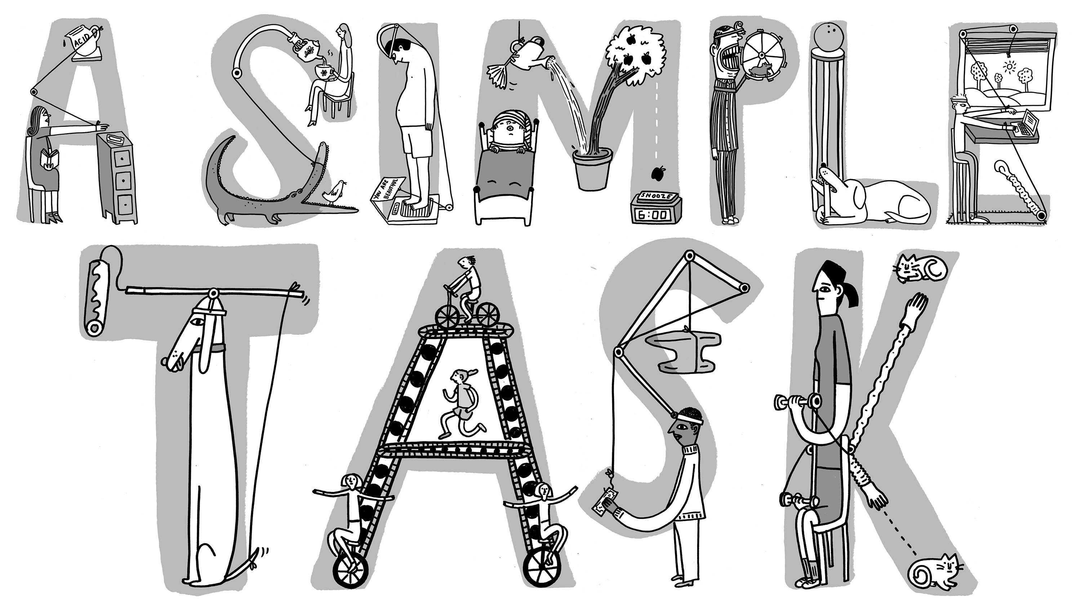
Rube Goldberg machine
About Rube Goldberg
For the uninitiated, Rube Goldberg was an American Pulitzer Prize winning cartoonist, sculptor, author, engineer, and inventor, and his work is a classic example of the melding of art and science. Goldberg began his career as an engineer, and later became a cartoonist who drew elaborate illustrations of contraptions made up of pulleys, cups, birds, balloons, and watering cans that were designed to solve a simple task such as opening a window or setting an alarm clock. Interestingly, Goldberg only drew the pictures, and never built any of his inventions. However, these pictures have since served as inspiration for makers and builders who want the challenge of making wild inventions to solve everyday problems. Rube Goldberg definition
And apparently, Rube Goldberg is a now an adjective in the dictionary!
Step 1: Get Inspired
First things first, you’ll want to watch some Rube Goldberg contraptions in action to get inspired.
Rube Goldberg videos and images
Step 2: Solve a Problem
Next, come up with a simple problem that you’re trying to solve. For example:
Ring a Bell
Drop a bottle in a recycling bin
Hammer a nail
Erase a chalkboard
Pop a Balloon
Put toothpaste on a toothbrush
Turn off a light
Crush a can
Once you have a problem sorted out (and don’t worry – you can change this later if you want), gather supplies…

Slide 19
Rube Goldberg machine
Step 3: Sketch it out completely
Rube Goldberg Gallery
Step 4: Gather Supplies
Supply list
Step 5: Build Your Machine!
Once you have the supplies ready, start building.
Tips for Success
Success breeds enthusiasm, so keep the steps to a minimum. You can always add more as you go.
Keep your expectations low! You will make mistakes!
Ask for input
Work collaboratively
Aim to have fun

